Slide 1
Introduction to Pandas and NumPy
Alexander victor alexander.victor@dbs.ie

Slide 2
Why pandas?
One of the most popular library that data scientists use
Labeled axes to avoid misalignment of data
When merge two tables, some rows may be different
Missing values or special values may need to be removed or replaced
 | height | Weight | Weight2 | age | Gender
Amy | 160 | 125 | 126 | 32 | 2
Bob | 170 | 167 | 155 | -1 | 1
Chris | 168 | 143 | 150 | 28 | 1
David | 190 | 182 | NA | 42 | 1
Ella | 175 | 133 | 138 | 23 | 2
Frank | 172 | 150 | 148 | 45 | 1
 | salary | Credit score
Alice | 50000 | 700
Bob | NA | 670
Chris | 60000 | NA
David | -99999 | 750
Ella | 70000 | 685
Tom | 45000 | 660

Slide 3
Overview
Created by Wes McKinney in 2008, now maintained by many others.
Author of one of the textbooks: Python for Data Analysis
Powerful and productive Python data analysis and Management Library
Panel Data System
The name is derived from the term "panel data", an econometrics term for data sets that include both time-series and cross-sectional data
Its an open source product.

Slide 4
Overview - 2
Python Library to provide data analysis features similar to: R, MATLAB, SAS
Rich data structures and functions to make working with data structure fast, easy and expressive.
It is built on top of NumPy
Key components provided by Pandas:
Series
DataFrame
From now on:
from pandas import Series, DataFrame
import pandas as pd

Slide 5
Series
One dimensional array-like object
It contains array of data (of any NumPy data type) with associated indexes. (Indexes can be strings or integers or other data types.)
By default , the series will get indexing from 0 to N where N = size -1
from pandas import Series, DataFrame
import pandas as pd
obj = Series([4, 7, -5, 3])
print(obj)
print(obj.index)
print(obj.values)
#Output
0 4
1 7
2 -5
3 3
dtype: int64
RangeIndex(start=0, stop=4, step=1)
[ 4 7 -5 3]

Slide 6
Series – referencing elements
obj2 = Series([4, 7, -5, 3], index=['d', 'b', 'a', 'c'])
print(obj2)
#Output
d 4
b 7
a -5
c 3
dtype: int64
print(obj2.index)
#Output
Index(['d', 'b', 'a', 'c'], dtype='object')
print(obj2.values)
#Output
[ 4 7 -5 3]
print(obj2['a'])
#Output
-5
obj2['d']= 10
print(obj2[['d', 'c', 'a']])
#Output
d 10
c 3
a -5
dtype: int64
print(obj2[:2])
#Output
d 10
b 7
dtype: int64
print(obj2.a)
#Output
-5

Slide 7
Series – array/dict operations
Can be thought of as a dict. Can be constructed from a dict directly.
obj3 = Series({'d': 4, 'b': 7, 'a': -5, 'c':3 })
print(obj3)
#output
d 4
b 7
a -5
c 3
dtype: int64
obj4 = obj3[obj3>0]
print(obj4)
#output
d 10
b 7
c 3
dtype: int64
print(obj3**2)
#output
d 100
b 49
a 25
c 9
dtype: int64
print(‘b’ in obj3)
#output
true
numpy array operations can also be applied, which will preserve the index-value link

Slide 8
Series – from dictionary
print(pd.isnull(obj4))
#output
Texas False
Ohio False
Oregon False
Iowa True
dtype: bool
print(pd.notnull(obj4))
#output
Texas True
Ohio True
Oregon True
Iowa False
dtype: bool
print(obj4[obj4.notnull()])
#output
Texas 10.0
Ohio 20.0
Oregon 15.0
dtype: float64
sdata = {'Texas': 10, 'Ohio': 20, 'Oregon': 15, 'Utah': 18}
states = ['Texas', 'Ohio', 'Oregon', 'Iowa']
obj4 = Series(sdata, index=states)
print(obj4)
#output
Texas 10.0
Ohio 20.0
Oregon 15.0
Iowa NaN
dtype: float64
dictionary
Missing value

Slide 9
Series – auto alignment
sdata = {'Texas': 10, 'Ohio': 20, 'Oregon': 15, 'Utah': 18}
states = ['Texas', 'Ohio', 'Oregon', 'Iowa']
obj4 = Series(sdata, index=states)
print(obj4)
#Output
Texas 10.0
Ohio 20.0
Oregon 15.0
Iowa NaN
dtype: float64
sdata = {'Texas': 10, 'Ohio': 20, 'Oregon': 15, 'Utah': 18}
states = ['Texas', 'Ohio', 'Oregon', 'Utah']
obj5 = Series(sdata, index=states)
print(obj5)
#Output
Texas 10
Ohio 20
Oregon 15
Utah 18
dtype: int64
print(obj4.add(obj5))
#output
Iowa NaN
Ohio 40.0
Oregon 30.0
Texas 20.0
Utah NaN
dtype: float64
Notes:
print(obj4.add(obj5, fill_value=0)) to avoid NaN

Slide 10
Series name and index name
sdata = {'Texas': 10, 'Ohio': 20, 'Oregon': 15, 'Utah': 18}
states = ['Texas', 'Ohio', 'Oregon', 'Iowa']
obj4 = Series(sdata, index=states)
obj4.name = 'population'
obj4.index.name = 'state'
print(obj4)
#output
state
Texas 10.0
Ohio 20.0
Oregon 15.0
Iowa NaN
Name: population, dtype: float64

Slide 11
Series name and index name
Index of a series can be changed to a different index.
obj4.index = ['Florida', 'New York', 'Kentucky', 'Georgia']
Florida 10.0
New York 20.0
Kentucky 15.0
Georgia NaN
Name: population, dtype: float64
Index object itself is immutable.
obj4.index[2]='California'
TypeError: Index does not support mutable operations
print(obj4.index)
Index(['Florida', 'New York', 'Kentucky', 'Georgia'], dtype='object')

Slide 12
Indexing, selection and filtering
Series can be sliced/accessed with label-based indexes, or using position-based indexes
S = Series(range(4), index=['zero', 'one', 'two', 'three'])
print(S['two'])
2
print(S[['zero', 'two']])
zero 0
two 2
dtype: int64
print(S[2])
2
print(S[[0,2]])
zero 0
two 2
dtype: int64
list operator for items >1

Slide 13
Indexing, selection and filtering
Series can be sliced/accessed with label-based indexes, or using position-based indexes
S = Series(range(4), index=['zero', 'one', 'two', 'three'])
print(S[:2])
zero 0
one 1
dtype: int32
print(S['zero': 'two'])
zero 0
one 1
two 2
dtype: int32
print(S[S > 1])
two 2
three 3
dtype: int32
print(S[-2:])
two 2
three 3
dtype: int32
Inclusive
Notes:
Slices are

Slide 14
Activity 4
Create a random list of 10 integers in the range from 1 to 100
Generate a Series using above list with index values of 1-10
Name your Series “Random Numbers”
Name your index “idx”
Now generate the Squares of all the values in the Series
display last 4 items of this Series
Also display all the numbers >500 as a list (without the index)

Slide 15
DataFrame
A DataFrame is a tabular data structure comprised of rows and columns, akin to a spreadsheet or database table.
It can be treated as an ordered collection of columns
Each column can be a different data type
Have both row and column indices
data = {'state': ['Ohio', 'Ohio', 'Ohio', 'Nevada', 'Nevada'],
'year': [2000, 2001, 2002, 2001, 2002],
'pop': [1.5, 1.7, 3.6, 2.4, 2.9]}
frame = DataFrame(data)
print(frame)
#output
state year pop
0 Ohio 2000 1.5
1 Ohio 2001 1.7
2 Ohio 2002 3.6
3 Nevada 2001 2.4
4 Nevada 2002 2.9

Slide 16
DataFrame – specifying columns and indices
Order of columns/rows can be specified.
Columns not in data will have NaN.
frame2 = DataFrame(data, columns=['year', 'state', 'pop', 'debt'], index=['A', 'B', 'C', 'D', 'E'])
Print(frame2)
year state pop debt
A 2000 Ohio 1.5 NaN
B 2001 Ohio 1.7 NaN
C 2002 Ohio 3.6 NaN
D 2001 Nevada 2.4 NaN
E 2002 Nevada 2.9 NaN
Same order
Initialized with NaN

Slide 17
DataFrame – from nested dict of dicts
Outer dict keys as columns and inner dict keys as row indices
pop = {'Nevada': {2001: 2.9, 2002: 2.9}, 'Ohio': {2002: 3.6, 2001: 1.7, 2000: 1.5}}
frame3 = DataFrame(pop)
print(frame3)
#output
Nevada Ohio
2000 NaN 1.5
2001 2.9 1.7
2002 2.9 3.6
Transpose
print(frame3.T)
2000 2001 2002
Nevada NaN 2.9 2.9
Ohio 1.5 1.7 3.6
Union of inner keys (in sorted order)

Slide 18
DataFrame – index, columns, values
frame3.index.name = 'year'
frame3.columns.name='state‘ print(frame3)
state Nevada Ohio
year
2000 NaN 1.5
2001 2.9 1.7
2002 2.9 3.6
print(frame3.index)
Int64Index([2000, 2001, 2002], dtype='int64', name='year')
print(frame3.columns)
Index(['Nevada', 'Ohio'], dtype='object', name='state')
print(frame3.values)
[[nan 1.5]
[2.9 1.7]
[2.9 3.6]]

Slide 19
DataFrame – retrieving a column
A column in a DataFrame can be retrieved as a Series by dict-like notation or as attribute
data = {'state': ['Ohio', 'Ohio', 'Ohio', 'Nevada', 'Nevada'],
'year': [2000, 2001, 2002, 2001, 2002],
'pop': [1.5, 1.7, 3.6, 2.4, 2.9]}
frame = DataFrame(data)
print(frame['state'])
0 Ohio
1 Ohio
2 Ohio
3 Nevada
4 Nevada
Name: state, dtype: object
print(frame.state)
0 Ohio
1 Ohio
2 Ohio
3 Nevada
4 Nevada
Name: state, dtype: object

Slide 20
Activity 5
Download the following csv file and load it to your python module or use the url directly in pd.read_csv(url) which will read it to a DataFrame
https://www.cs.odu.edu/~sampath/courses/f19/cs620/files/data/values.csv
Calculate the average and standard deviation (std) of the column factor_1 and display the result.
Pandas mean() and std()
Notes:
Obj = pd.read_csv(‘values.csv’)

Slide 21
DataFrame – getting rows
loc for using indexes and iloc for using positions
loc gets rows (or columns) with particular labels from the index.
iloc gets rows (or columns) at particular positions in the index (so it only takes integers).
data = {'state': ['Ohio', 'Ohio', 'Ohio', 'Nevada', 'Nevada'],
'year': [2000, 2001, 2002, 2001, 2002],
'pop': [1.5, 1.7, 3.6, 2.4, 2.9]}
frame2 = DataFrame(data, columns=['year', 'state', 'pop', 'debt'], index=['A', 'B', 'C', 'D', 'E'])
print(frame2)
year state pop debt
A 2000 Ohio 1.5 NaN
B 2001 Ohio 1.7 NaN
C 2002 Ohio 3.6 NaN
D 2001 Nevada 2.4 NaN
E 2002 Nevada 2.9 NaN
print(frame2.loc['A'])
year 2000
state Ohio
pop 1.5
debt NaN
Name: A, dtype: object
print(frame2.loc[['A', 'B']])
year state pop debt
A 2000 Ohio 1.5 NaN
B 2001 Ohio 1.7 NaN
print(frame2.loc['A':'E',['state','pop']])
state pop
A Ohio 1.5
B Ohio 1.7
C Ohio 3.6
D Nevada 2.4
E Nevada 2.9
print(frame2.iloc[1:3])
year state pop debt
B 2001 Ohio 1.7 NaN
C 2002 Ohio 3.6 NaN
print(frame2.iloc[:,1:3])
state pop
A Ohio 1.5
B Ohio 1.7
C Ohio 3.6
D Nevada 2.4
E Nevada 2.9

Slide 22
DataFrame – modifying columns
frame2['debt'] = 0
print(frame2)
year state pop debt
A 2000 Ohio 1.5 0
B 2001 Ohio 1.7 0
C 2002 Ohio 3.6 0
D 2001 Nevada 2.4 0
E 2002 Nevada 2.9 0
frame2['debt'] = range(5)
print(frame2)
year state pop debt
A 2000 Ohio 1.5 0
B 2001 Ohio 1.7 1
C 2002 Ohio 3.6 2
D 2001 Nevada 2.4 3
E 2002 Nevada 2.9 4
val = Series([10, 10, 10], index = ['A', 'C', 'D'])
frame2['debt'] = val
print(frame2)
year state pop debt
A 2000 Ohio 1.5 10.0
B 2001 Ohio 1.7 NaN
C 2002 Ohio 3.6 10.0
D 2001 Nevada 2.4 10.0
E 2002 Nevada 2.9 NaN
Rows or individual elements can be modified similarly. Using loc or iloc.

Slide 23
DataFrame – removing columns
del frame2['debt']
print(frame2)
year state pop
A 2000 Ohio 1.5
B 2001 Ohio 1.7
C 2002 Ohio 3.6
D 2001 Nevada 2.4
E 2002 Nevada 2.9
Notes:
Df = frame.drop('r1', 0) # 0 for row, 1 for columns

Slide 24
More on DataFrame indexing
import numpy as np
data = np.arange(9).reshape(3,3)
print(data)
[[0 1 2]
[3 4 5]
[6 7 8]]
frame = DataFrame(data, index=['r1', 'r2', 'r3'], columns=['c1', 'c2', 'c3'])
print(frame)
c1 c2 c3
r1 0 1 2
r2 3 4 5
r3 6 7 8
print(frame['c1'])
r1 0
r2 3
r3 6
Name: c1, dtype: int32
print(frame.loc['r1'])
c1 0
c2 1
c3 2
Name: r1, dtype: int32
print(frame['c1']['r1'])
0
print(frame[['c1', 'c3']])
c1 c3
r1 0 2
r2 3 5
r3 6 8
print(frame.loc[['r1','r3']])
c1 c2 c3
r1 0 1 2
r3 6 7 8
print(frame.iloc[:2])
c1 c2 c3
r1 0 1 2
r2 3 4 5
print(frame[:2])
c1 c2 c3
r1 0 1 2
r2 3 4 5
Row slices

Slide 25
More on DataFrame indexing - 2
print(frame.loc[['r1', 'r2'], ['c1', 'c2']])
c1 c2
r1 0 1
r2 3 4
print(frame.iloc[:2,:2])
c1 c2
r1 0 1
r2 3 4
v = DataFrame(np.arange(9).reshape(3,3), index=['a', 'a', 'b'], columns=['c1','c2','c3'])
print(v)
c1 c2 c3
a 0 1 2
a 3 4 5
b 6 7 8
print(v.loc['a'])
c1 c2 c3
a 0 1 2
a 3 4 5
print(frame.loc['r1':'r3', 'c1':'c3'])
c1 c2 c3
r1 0 1 2
r2 3 4 5
r3 6 7 8
Duplicated keys

Slide 26
More on DataFrame indexing - 3
print(frame)
c1 c2 c3
r1 0 1 2
r2 3 4 5
r3 6 7 8
print(frame <3)
c1 c2 c3
r1 True True True
r2 False False False
r3 False False False
print(frame[frame['c1']>0])
c1 c2 c3
r2 3 4 5
r3 6 7 8
print(frame['c1']>0)
r1 False
r2 True
r3 True
Name: c1, dtype: bool
frame[frame<3] = 3
print(frame)
c1 c2 c3
r1 3 3 3
r2 3 4 5
r3 6 7 8

Slide 27
Activity 6
Create a numpy array of the shape (3,5): 3 rows and 5 columns with random values from 1 to 100
Use np.random.randint(low,high, (shape))
Use the numpy array to generate a Data Frame with index = a,b,c and columns 1,2,3,4, 5
Transpose (using .T) the DataFrame and change the values less than 40 to 0 in the Data Frame.
Notes:
Obj = pd.read_csv(‘values.csv’)

Slide 28
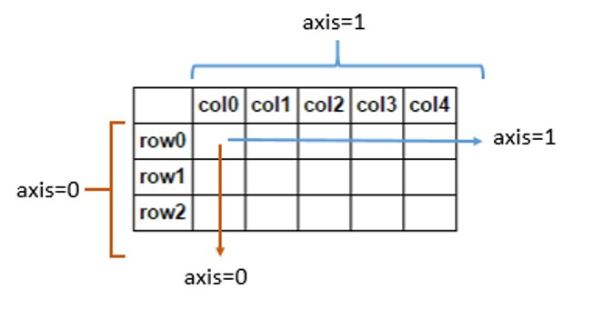
Removing rows/columns
print(frame)
c1 c2 c3
r1 0 1 2
r2 3 4 5
r3 6 7 8
print(frame.drop(['r1']))
c1 c2 c3
r2 3 4 5
r3 6 7 8
print(frame.drop(['r1','r3']))
c1 c2 c3
r2 3 4 5
print(frame.drop(['c1'], axis=1))
c2 c3
r1 1 2
r2 4 5
r3 7 8
This returns a new object

Slide 29
Reindexing
Alter the order of rows/columns of a DataFrame or order of a series according to new index
frame2 = frame.reindex(columns=['c2', 'c3', 'c1'])
print(frame2)
c2 c3 c1
r1 1 2 0
r2 4 5 3
r3 7 8 6
frame2 = frame.reindex(['r1', 'r3', 'r2', 'r4'])
c1 c2 c3
r1 0.0 1.0 2.0
r3 6.0 7.0 8.0
r2 3.0 4.0 5.0
r4 NaN NaN NaN
This returns a new object

Slide 30
Function application and mapping
DataFrame.applymap(f) applies f to every entry
DataFrame.apply(f) applies f to every column (default) or row
print(frame)
c1 c2 c3
r1 0 1 2
r2 3 4 5
r3 6 7 8
def square(x):
return x**2
print(frame.applymap(square))
c1 c2 c3
r1 0 1 4
r2 9 16 25
r3 36 49 64
def max_minus_min(x):
return max(x)-min(x)
print(frame.apply(max_minus_min))
c1 6
c2 6
c3 6
dtype: int64
print(frame.apply(max_minus_min,axis=1))
r1 2
r2 2
r3 2
dtype: int64

Slide 31
Function application and mapping - 2
def max_min(x):
return Series([max(x), min(x)], index=['max', 'min'])
print(frame.apply(max_min))
c1 c2 c3
max 6 7 8
min 0 1 2

Slide 32
Other DataFrame functions
sort_values()
sort_index()
frame.index=['A', 'C', 'B']; frame.columns=['b','a','c'];
print(frame)
b a c
A 0 1 2
C 3 4 5
B 6 7 8
print(frame.sort_index())
b a c
A 0 1 2
B 6 7 8
C 3 4 5
print(frame.sort_index(axis=1))
a b c
A 1 0 2
C 4 3 5
B 7 6 8
frame = DataFrame(np.random.randint(0, 10, 9).reshape(3,-1), index=['r1', 'r2', 'r3'], columns=['c1', 'c2', 'c3'])
print(frame)
c1 c2 c3
r1 6 9 0
r2 8 2 9
r3 8 0 6
print(frame.sort_values(by='c1'))
c1 c2 c3
r1 6 9 0
r2 8 2 9
r3 8 0 6
print(frame.sort_values(axis=1,by=['r3','r1']))
c2 c3 c1
r1 9 0 6
r2 2 9 8
r3 0 6 8

Slide 33
Activity 7
Use the Data Frame created at the Activity 6
Apply a lambda function to calculate the square root of each value in the data frame
import math math.sqrt()
Notes:
Obj = pd.read_csv(‘values.csv’)

Slide 34
Other DataFrame functions
mean()
Mean(axis=0, skipna=True)
sum()
cumsum()
describe(): return summary statistics of each column
for numeric data: mean, std, max, min, 25%, 50%, 75%, etc.
For non-numeric data: count, uniq, most-frequent item, etc.
corr(): correlation between two Series, or between columns of a DataFrame
corr_with(): correlation between columns of DataFram and a series or between the columns of another DataFrame

Slide 35
Handling missing data
Filtering out missing values
from numpy import nan as NaN
data = Series([1, NaN, 2.5, NaN, 6])
print(data)
0 1.0
1 NaN
2 2.5
3 NaN
6.0
dtype: float64
print(data.notnull())
0 True
1 False
2 True
3 False
4 True
dtype: bool
print(data[data.notnull()])
0 1.0
2 2.5
4 6.0
dtype: float64
print(data.dropna())
0 1.0
2 2.5
4 6.0
dtype: float64
Notes:
s.dropna(inplace=True)

Slide 36
Handling missing data - 2
data = DataFrame([[1, 2, 3], [1, NaN, NaN], [NaN, NaN, NaN], [NaN, 4, 5]])
print(data)
0 1 2
0 1.0 2.0 3.0
1 1.0 NaN NaN
2 NaN NaN NaN
NaN 4.0 5.0
print(data.dropna())
0 1 2
0 1.0 2.0 3.0
print(data.dropna(how='all'))
0 1 2
0 1.0 2.0 3.0
1 1.0 NaN NaN
NaN 4.0 5.0
print(data.dropna(axis=1, how='all'))
0 1 2
0 1.0 2.0 3.0
1 1.0 NaN NaN
2 NaN NaN NaN
3 NaN 4.0 5.0
data[4]=NaN
print(data)
0 1 2 4
0 1.0 2.0 3.0 NaN
1 1.0 NaN NaN NaN
2 NaN NaN NaN NaN
NaN 4.0 5.0 NaN
print(data.dropna(axis=1, how='all'))
0 1 2
0 1.0 2.0 3.0
1 1.0 NaN NaN
2 NaN NaN NaN
3 NaN 4.0 5.0

Slide 37
Filling in missing data
print(data)
0 1 2 4
0 1.0 2.0 3.0 NaN
1 1.0 NaN NaN NaN
2 NaN NaN NaN NaN
NaN 4.0 5.0 NaN
print(data.fillna(0))
0 1 2 4
0 1.0 2.0 3.0 0.0
1 1.0 0.0 0.0 0.0
2 0.0 0.0 0.0 0.0
3 0.0 4.0 5.0 0.0
print(data)
0 1 2
0 1.0 2.0 3.0
1 1.0 NaN NaN
2 NaN NaN NaN
3 NaN 4.0 5.0
print(data.fillna(data.mean(skipna=True)))
0 1 2
0 1.0 2.0 3.0
1 1.0 3.0 4.0
2 1.0 3.0 4.0
3 1.0 4.0 5.0
print(data.fillna(0, inplace=True))
print(data)
0 1 2 4
0 1.0 2.0 3.0 0.0
1 1.0 0.0 0.0 0.0
2 0.0 0.0 0.0 0.0
3 0.0 4.0 5.0 0.0
replace nan with column mean
Modify the dataframe instead of returning a new object (default)

Slide 38
Numerical Python (NumPy)
NumPy is the most foundational package for numerical computing in Python.
If you are going to work on data analysis or machine learning projects, then having a solid understanding of NumPy is nearly mandatory.
Indeed, many other libraries, such as pandas and scikit-learn, use NumPy’s array objects as the lingua franca for data exchange.
One of the reasons as to why NumPy is so important for numerical computations is because it is designed for efficiency with large arrays of data. The reasons for this include:
- It stores data internally in a continuous block of memory, independent of other in-built Python objects.
- It performs complex computations on entire arrays without the need for for loops.

Slide 39
What you’ll find in NumPy
ndarray: an efficient multidimensional array providing fast array-orientated arithmetic operations and flexible broadcasting capabilities.
Mathematical functions for fast operations on entire arrays of data without having to write loops.
Tools for reading/writing array data to disk and working with memory-mapped files.
Linear algebra, random number generation, and Fourier transform capabilities.
A C API for connecting NumPy with libraries written in C, C++, and FORTRAN. This is why Python is the language of choice for wrapping legacy codebases.

Slide 40
The NumPy ndarray: A multi-dimensional array object
The NumPy ndarray object is a fast and flexible container for large data sets in Python.
NumPy arrays are a bit like Python lists, but are still a very different beast at the same time.
Arrays enable you to store multiple items of the same data type. It is the facilities around the array object that makes NumPy so convenient for performing math and data manipulations.

Slide 41
Ndarray vs. lists
By now, you are familiar with Python lists and how incredibly useful they are.
So, you may be asking yourself: “I can store numbers and other objects in a Python list and do all sorts of computations and manipulations through list comprehensions, for-loops etc. What do I need a NumPy array for?”
There are very significant advantages of using NumPy arrays overs lists.

Slide 42


Creating a NumPy array
To understand these advantages, lets create an array.
One of the most common, of the many, ways to create a NumPy array is to create one from a list by passing it to the np.array() function.
In:
Out:

Slide 43
Differences between lists and ndarrays
The key difference between an array and a list is that arrays are designed to handle vectorised operations while a python lists are not.
That means, if you apply a function, it is performed on every item in the array, rather than on the whole array object.

Slide 44




Let’s suppose you want to add the number 2 to every item in the list. The intuitive way to do this is something like this:
In:
Out:
That was not possible with a list, but you can do that on an array:
In:
Out:

Slide 45
It should be noted here that, once a Numpy array is created, you cannot increase its size.
To do so, you will have to create a new array.

Slide 46


Create a 2d array from a list of list
You can pass a list of lists to create a matrix-like a 2d array.
In:
Out:

Slide 47


The dtype argument
You can specify the data-type by setting the dtype() argument.
Some of the most commonly used NumPy dtypes are: float, int, bool, str, and object.
In:
Out:

Slide 48
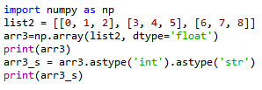
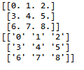
The astype argument
You can also convert it to a different data-type using the astype method.
In:
Out:
Remember that, unlike lists, all items in an array have to be of the same type.

Slide 49

dtype=‘object’
However, if you are uncertain about what data type your array will hold, or if you want to hold characters and numbers in the same array, you can set the dtype as 'object'.
In:
Out:

Slide 50

The tolist() function
You can always convert an array into a list using the tolist() command.
In:
Out:

Slide 51
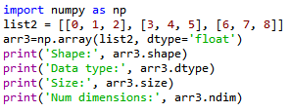

Inspecting a NumPy array
There are a range of functions built into NumPy that allow you to inspect different aspects of an array:
In:
Out:

Slide 52


Extracting specific items from an array
You can extract portions of the array using indices, much like when you’re working with lists.
Unlike lists, however, arrays can optionally accept as many parameters in the square brackets as there are number of dimensions
In:
Out:

Slide 53


Boolean indexing
A boolean index array is of the same shape as the array-to-be-filtered, but it only contains TRUE and FALSE values.
In:
Out:

Slide 54
Pandas
Pandas, like NumPy, is one of the most popular Python libraries for data analysis.
It is a high-level abstraction over low-level NumPy, which is written in pure C.
Pandas provides high-performance, easy-to-use data structures and data analysis tools.
There are two main structures used by pandas; data frames and series.

Slide 55


Indices in a pandas series
A pandas series is similar to a list, but differs in the fact that a series associates a label with each element. This makes it look like a dictionary.
If an index is not explicitly provided by the user, pandas creates a RangeIndex ranging from 0 to N-1.
Each series object also has a data type.
In:
Out:

Slide 56




As you may suspect by this point, a series has ways to extract all of the values in the series, as well as individual elements by index.
In:
Out:
You can also provide an index manually.
In:
Out:

Slide 57
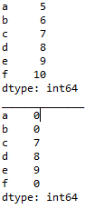

It is easy to retrieve several elements of a series by their indices or make group assignments.
Out:
In:

Slide 58
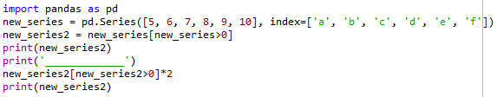
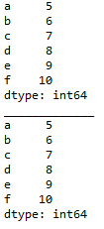
Filtering and maths operations
Filtering and maths operations are easy with Pandas as well.
In:
Out:

Slide 59
Pandas data frame
Simplistically, a data frame is a table, with rows and columns.
Each column in a data frame is a series object.
Rows consist of elements inside series.
Case ID | Variable one | Variable two | Variable 3
1 | 123 | ABC | 10
2 | 456 | DEF | 20
3 | 789 | XYZ | 30

Slide 60
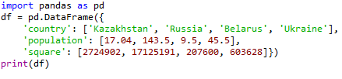

Creating a Pandas data frame
Pandas data frames can be constructed using Python dictionaries.
In:
Out:

Slide 61

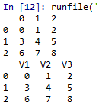
You can also create a data frame from a list.
In:
Out:

Slide 62
You can ascertain the type of a column with the type() function.
In:
Out:

Slide 63
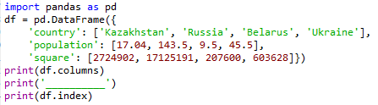

A Pandas data frame object as two indices; a column index and row index.
Again, if you do not provide one, Pandas will create a RangeIndex from 0 to N-1.
In:
Out:

Slide 64
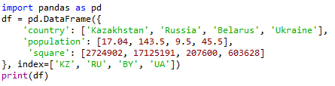

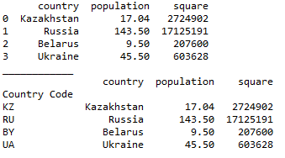
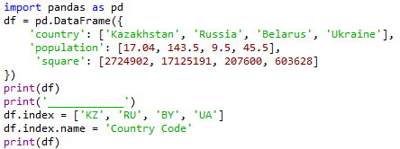
There are numerous ways to provide row indices explicitly.
For example, you could provide an index when creating a data frame:
In:
Out:
or do it during runtime.
Here, I also named the index ‘country code’.
Out:
In:

Slide 65

Row access using index can be performed in several ways.
First, you could use .loc() and provide an index label.
In:
Out:
Second, you could use .iloc() and provide an index number
In:
Out:

Slide 66


A selection of particular rows and columns can be selected this way.
In:
Out:
You can feed .loc() two arguments, index list and column list, slicing operation is supported as well:
In:
Out:

Slide 67

Filtering
Filtering is performed using so-called Boolean arrays.

Slide 68



Deleting columns
You can delete a column using the drop() function.
In:
Out:
In:
Out:

Slide 69
Reading from and writing to a file
Pandas supports many popular file formats including CSV, XML, HTML, Excel, SQL, JSON, etc.
Out of all of these, CSV is the file format that you will work with the most.
You can read in the data from a CSV file using the read_csv() function.
Similarly, you can write a data frame to a csv file with the to_csv() function.

Slide 70
Pandas has the capacity to do much more than what we have covered here, such as grouping data and even data visualisation.
However, as with NumPy, we don’t have enough time to cover every aspect of pandas here.

Slide 71
Exploratory data analysis (EDA)
Exploring your data is a crucial step in data analysis. It involves:
Organising the data set
Plotting aspects of the data set
Maybe producing some numerical summaries; central tendency and spread, etc.
“Exploratory data analysis can never be the whole story, but nothing else can serve as the foundation stone.” - John Tukey.

Slide 72

Download the data
Download the Pokemon dataset from:
https://github.com/LewBrace/da_and_vis_python
Unzip the folder, and save the data file in a location you’ll remember.

Slide 73
Reading in the data
First we import the Python packages we are going to use.
Then we use Pandas to load in the dataset as a data frame.
NOTE: The argument index_col argument states that we'll treat the first column of the dataset as the ID column.
NOTE: The encoding argument allows us to by pass an input error created by special characters in the data set.

Slide 74
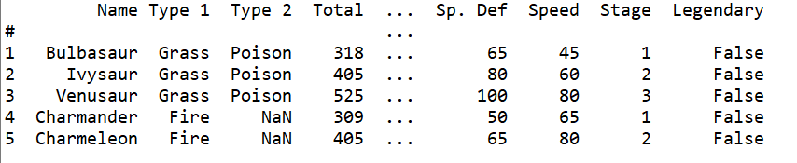
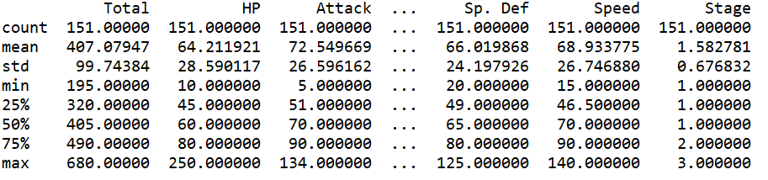
Examine the data set

